Slide 1



Chapter 10
Inferential
Statistics:
Two Group
Designs
@ 2012 Wadsworth, Cengage Learning

Slide 2
Topics
Parametric Statistics
Nonparametric Tests

Slide 3
Parametric Statistics

Slide 4


Parametric Statistics
Null hypothesis tested in a two-group design using a two-tailed test:
Alternative hypothesis:

Slide 5

Parametric Statistics (cont’d.)
For a one-tailed test, the null hypothesis is
  Depending on which alternative hypothesis is being tested:
Alpha is typically set at .05 (α= .05)

Slide 6
Parametric Statistics (cont’d.)
Parametric tests
  The data fit a bell-shaped distribution
  Certain parameters are known
    Mean (μ)
    Standard deviation (σ)
  Use interval-ratio data

Slide 7

Parametric Statistics (cont’d.)
Independent-groups t test: a parametric inferential test for comparing sample means of two independent groups of scores
Example:

Slide 8

Parametric Statistics (cont’d.)
Formula for an independent-groups t test
Standard error of the difference between means
  The standard deviation of the sampling distribution of mean differences between dependent samples in a two-group experiment

Slide 9

Parametric Statistics (cont’d.)
Formula for converting the mean differences to standard errors

Slide 10
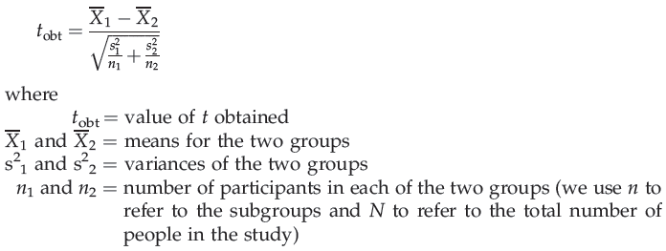
Parametric Statistics (cont’d.)
Putting all of this together, the formula for determining t is:

Slide 11

Parametric Statistics (cont’d.)
In APA style the result is reported as:
When a result is significant
  The p value is reported as less than (<) .05
p value or alpha level: indicates the probability of a Type I error
  We want this probability to be small

Slide 12
Parametric Statistics (cont’d.)
Three aspects of a study can increase power:
  Greater differences produced by the independent variable
  Less variability of raw scores in each condition
  Increased sample size

Slide 13
Parametric Statistics (cont’d.)
Effect size
  The proportion of variance in the dependent variable that is accounted for by the manipulation of the independent variable
Cohen’s d: inferential statistic for measuring effect size

Slide 14
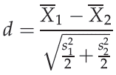
Parametric Statistics (cont’d.)
Formula for Cohen’s d
Report Cohen’s d with the t-score:

Slide 15

Parametric Statistics (cont’d.)
Measure effect size for the independent-groups t test using r²
  Use the formula:
If r² is .01, the effect size is small
If r² is .09, it is medium
If r² is .25, it is large

Slide 16

Parametric Statistics (cont’d.)
Formula for the 95% confidence interval:
Assumptions of the independent-groups t test:
  The data are interval-ratio scale
  The underlying distributions are bell-shaped
  The observations are independent
  Homogeneity of variance

Slide 17
Parametric Statistics (cont’d.)
Correlated-groups t test
  A parametric inferential test used to compare the means of two related (within- or matched- subjects) samples
Difference scores
  Scores representing the difference between subjects’ performance in one condition and their performance in a second condition

Slide 18

Parametric Statistics (cont’d.)
Standard error of the difference scores
  The standard deviation of the sampling distribution of differences between the means of independent samples in a two-sample experiment
For the correlated-groups t test, the formula for Cohen’s d is:

Slide 19
Parametric Statistics (cont’d.)
Assumptions for the correlated-groups t test:
  Same as those for the independent- groups t test except the observations are correlated

Slide 20
Nonparametric Tests

Slide 21
Nonparametric Tests
Wilcoxon rank-sum test: a nonparametric inferential test for comparing sample medians of two independent groups of scores
Highest rank should be equal to n₁ + n₂
First sum the ranks
  For the group expected to have the smaller total

Slide 22
Nonparametric Tests (cont’d.)
Assumptions of the Wilcoxon rank-sum test:
  The data are ratio, interval, or ordinal in scale
    All of which must be converted to ranked (ordinal) data
  The underlying distribution is not normal
  The observations are independent
Wilcoxon matched-pairs signed-ranks T test
  Similar to the correlated-groups t test
    Except that it is nonparametric and compares medians rather than means

Slide 23
Nonparametric Tests (cont’d.)
Assumptions of the Wilcoxon matched-pairs signed-ranks T test:
  The data are ratio, interval, or ordinal in scale
    All of which must be converted to ranked (ordinal) data
  The underlying distribution is not normal
  The observations are dependent or related

Slide 24

Nonparametric Tests (cont’d.)
Chi-square (χ²) test of independence
  A nonparametric inferential test used when frequency data have been collected to determine
  How well an observed breakdown of people over various categories fits some expected breakdown
  Formula:

Slide 25

Nonparametric Tests (cont’d.)
Phi coefficient: an inferential test used to determine effect size for a chi-square test
For a 2 X 2 contingency table, we use the phi coefficient, where:

Slide 26
Nonparametric Tests (cont’d.)
Assumptions of the χ² test of independence
  The sample is random
  The observations are independent
  The data are nominal

Slide 27
Summary
Use the appropriate statistic to analyze data
Consider whether the statistic should be a parametric or nonparametric
  Based on:
    The type of data collected
    The type of distribution to which the data conform
    Whether any parameters of the distribution are known
Consider whether a between-subjects or correlated-groups design has been used

